Slide 1
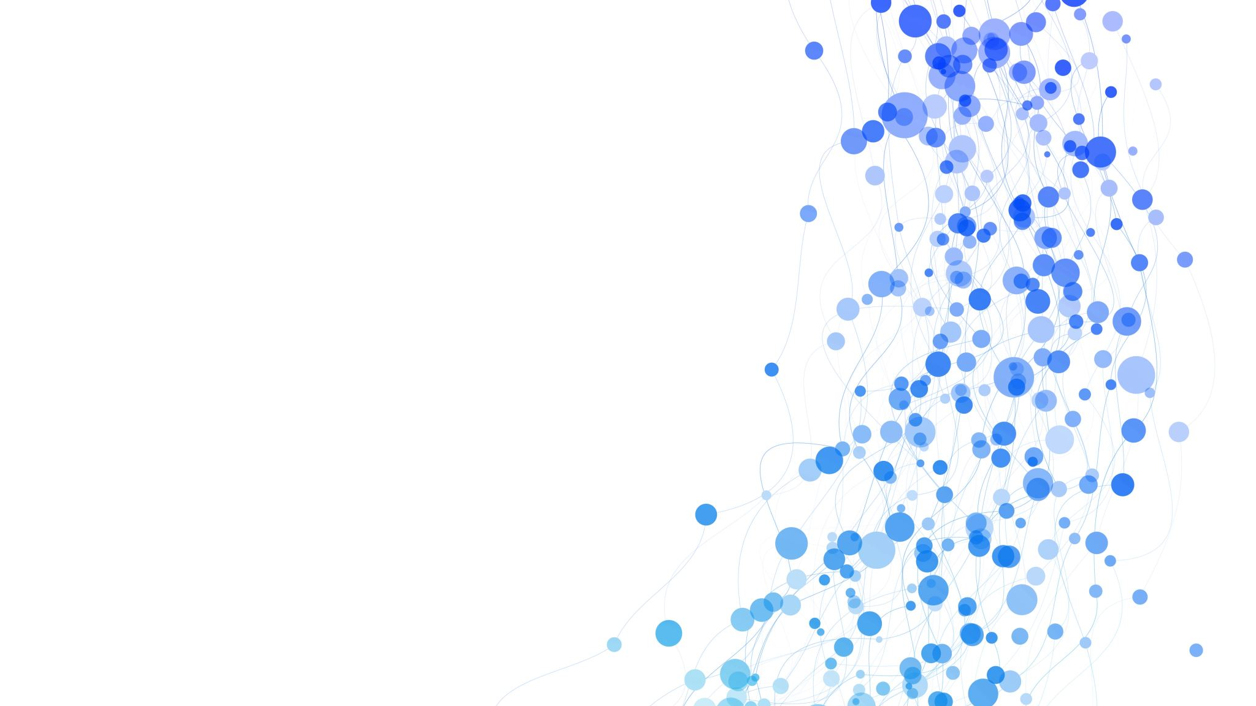
THEORIES OF LEADERSHIP POWER AND INFLUENCE
SPRING 2023
CHAPTER 12
FAREED QURESHI

Slide 2
DISCUSSION OBJECTIVES
Recognize
Recognize your natural leadership frame of reference and how you can expand your perspective.
Use
Use power and politics to help accomplish important organizational goals.
Identify
Identify types and sources of power in organizations and know how to increase power through political activity.
Use
Use the influence tactics of rational persuasion, friendliness, reciprocity, developing allies, direct appeal, and scarcity.

Slide 3
FOUR KINDS OF INFLUENTIAL LEADERSHIP
Transformational leadership
leadership characterized by the ability to bring about significant change in followers and the organization
Transactional leadership
Charismatic leadership
leaders who have the ability to inspire and motivate people to do more than they would normally do, despite obstacles and personal sacrifice
Emotional impact on followers
Coalitional leadership
leadership that involves developing allies and building a coalition of people who support the leader’s goals and can help influence others to implement the leader’s decisions and achieve the goals
Machiavellian-style leadership

Slide 4
POWER AND INFLUENCE
Power
The ability of one person or department in an organization to influence other people to bring about desired outcomes
Influence
The effect a person’s actions have on the attitudes, values, beliefs, or actions of others

Slide 5
FIVE TYPES OF LEADER POWER
Legitimate
Reward
Coercive
Expert
Referent
Position Power
Personal Power

Slide 6
RESPONSE TO THE USE OF POWER
Position Power
Personal Power
appropriate use
excessive use
Commitment
Compliance
Resistance

Slide 7
CHARACTERISTICS THAT AFFECT DEPENDENCY AND POWER IN ORGANIZATIONS
Leader has control over:
Leader has control over:
Resources seen as unimportant
Importance
Resources seen as very important
Widely available resources
Scarcity
Scarce resources
Resources with acceptable substitutes
Non
substitutability
Resources with no substitutes
Low dependency on leader = lower power
High dependency on leader = higher power

Slide 8
LEADER’S FRAMES OF REFERENCE
4. Symbolic
Mind-set: Sees organization as theater, spiritual meaning, dreams
Emphasis: Vision, culture & values, inspiration
Dangers: “Messiah” complex
3. Political
Mind-set: Sees organization as jungle, power, schemes
Emphasis: Resource allocation, negotiation, coalition building
Dangers: Power plays for purpose of self-interest
2. Human Resource
Mind-set: Sees organization as family, belonging, clan
Emphasis: People, support, empowerment
Dangers: Lack of content or substance
1. Structural
Mind-set: Sees organization as machine, economics, plans
Emphasis: Goals, systems, efficiency, formal authority
Dangers: Rigidity and tyranny

Slide 9

POLITICS
Activities to acquire, develop, and use power and other resources to obtain desired future outcomes when there is uncertainty or disagreement about choices

Slide 10

PRINCIPLES FOR ASSERTING INFLUENCE
Use rational persuasion
Make people like you
Rely on the rule of reciprocity
Develop allies
Ask for what you want
Remember the principle of scarcity
Extend formal authority with expertise and credibility

Slide 11
DON’T TAKE POWER PERSONALLY
Is the action consistent with the organization’s goals, rather than being self-motivated purely by self-interest?
Does the action respect the rights of individuals and groups affected by it?
Does the action meet the standards of fairness and equity?
Would you wish others to behave in the same way if the action affected you?

Slide 12

THAT IS ALL FOR TODAY!!

